Slide 1

Introduction to Entity Framework Core
ENTITY FRAMEWORK CORE - Draft

Slide 2
Overview
What is ORM
ORM: Object – Schema Mapping
What is Entity Framework Core
Why Entity Framework Core
Code and Deploy Across Platforms
Applications types for EF Core 2.0
Supported Database
Available Database Provider

Slide 3
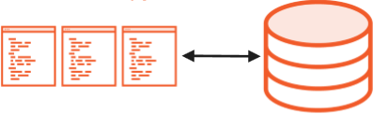
What is ORM
Object-Relational Mapper(ORM) is a framework that enables developers to work with a database using objects.

Slide 4
ORM
Manual Model Value Mapping
DIRECT
Call Object Getter
Connections/Session
Many CRUD Methods
Messy SQL Statements
ORM eliminates the need for most of the data-access code that developers usually need to write.
Notes:
If you compare direct connection with orm, direct approach need to do this and that…
- Manual Model Value Mapping – need to assign db column result to an object properties manually
While orm simply access using the getter of objects, orm handles the rest.

Slide 5
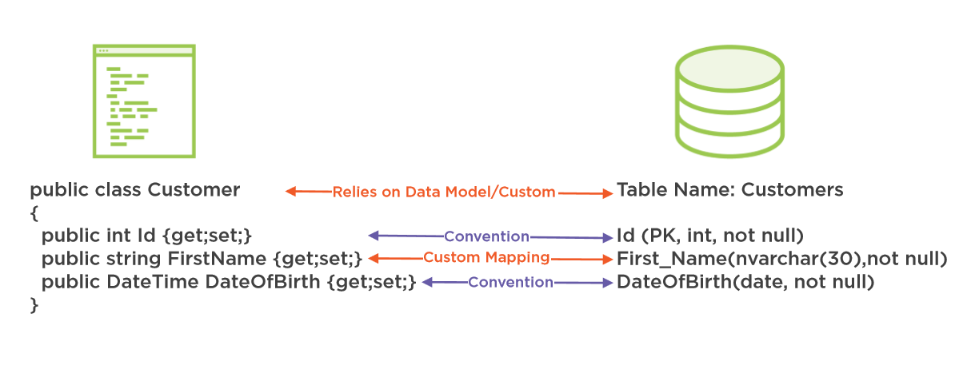
ORM: Object – Schema Mapping
ORM generates the SQL that the underlying database understands.

Slide 6
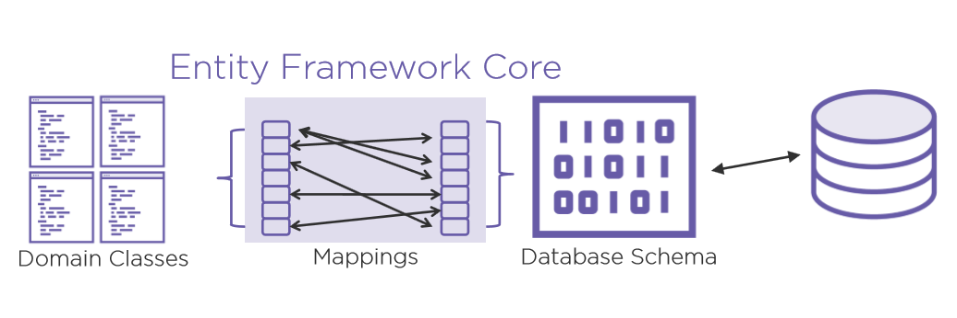
Entity Framework Core
Entity Framework is an ORM (Object-Relational Mapper) a.k.a. ADO.NET.
Latest release known as Entity Framework Core (EF core), a lightweight, extensible, and open source cross platform software.
EF core is Microsoft’s official data access platform.

Slide 7
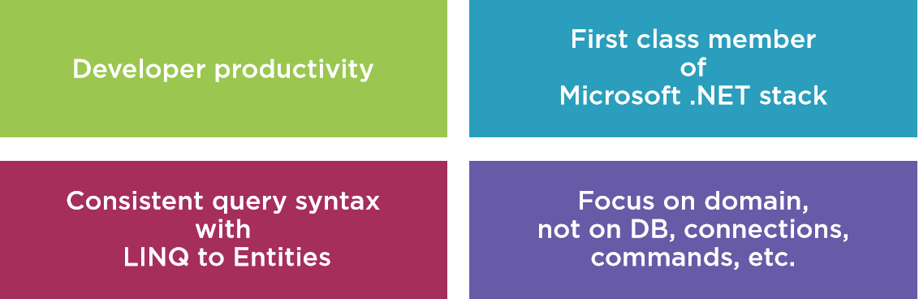
Why Entity Framework Core
Notes:
Simplify development.
- reduction of code
- code maintainability.
Domain Model pattern.
Focuses on business entities/real world objects(models) vs database schema/crud implementation

Slide 8
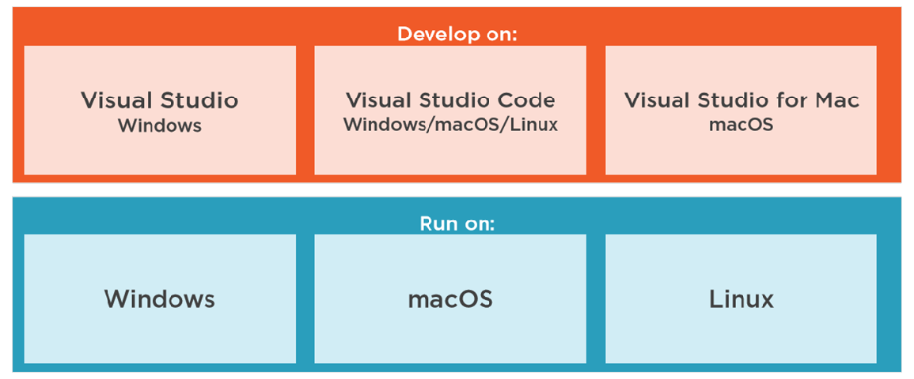
Code and Deploy Across Platforms

Slide 9
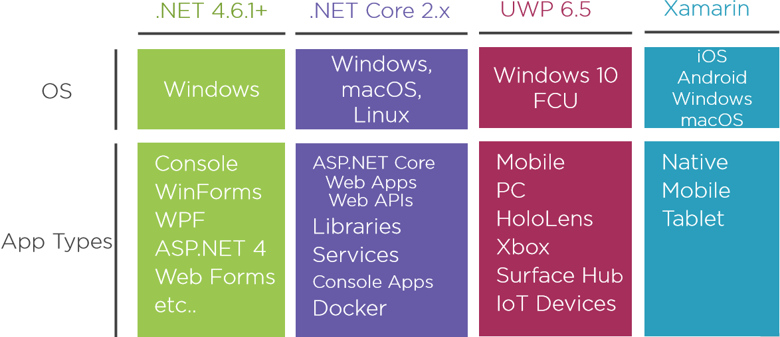
Applications types for EF Core 2.0

Slide 10
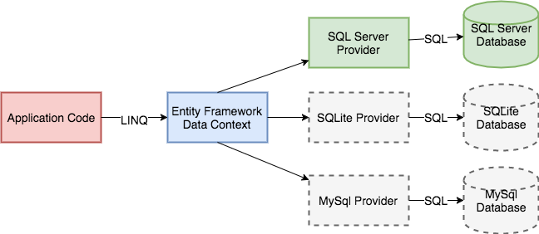
Supports Many Database Systems
Notes:
There is a middleware called database providers between ef core and database, thus ef core can support many types of database systems

Slide 11
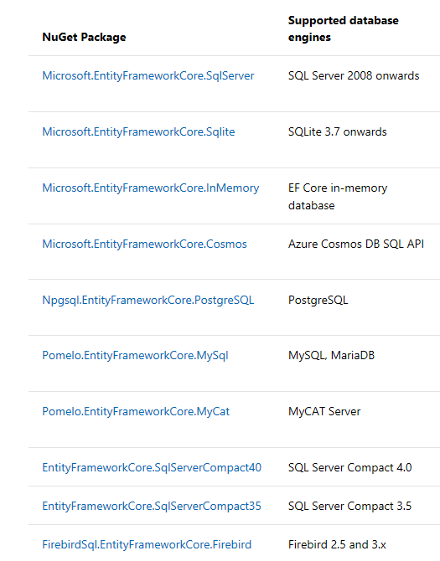
Available Database Provider
ADDTIONAL
Most Main Stream Database Systems:
SQL Server (Microsoft)
SQLite (Microsoft, Devart)
InMemory (Microsoft)
SQL Server Compact (Erik Eilskov Jensen (MVP))
MySQL (Oracle, Pomelo, Devart)
Oracle (Devart)
PostgreSQL (Npgsql/Shay Rojansky (MVP), Devart)
And Many More Through NuGet Packages…
(https://docs.microsoft.com/en-us/ef/core/providers/)
Notes:
These are some of the database supported through database providers

